Slide 1

MadeiraCloud
A river runs through the cloud

Slide 2
About Us
- 3rd party SaaS for AWS
- Found at June, 2011
- Team of 5
- Beijing, China
- Angel Funded
“Madeira River is the Amazon’s largest and most important tributary” - Wikipedia

Slide 3
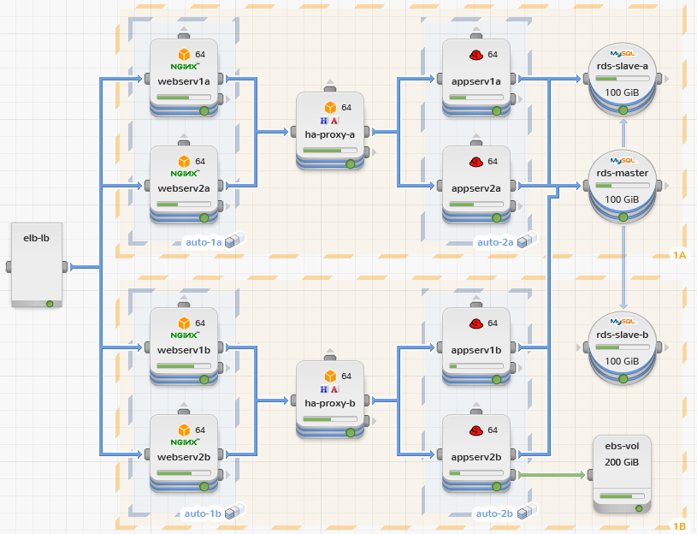
We want to “Visualize The Cloud”
- WYSIWYG IDE to build application infrastructure
- Live architecture view to understand how app behaves
- Monitoring, Management, Analysis

Slide 4
Our Stack
- EBS instance for website/application hosting
- Prebaked AMI/Script for quick provision
- SimpleDB for data storage
- SES for sending emails
- AutoScaling/ELB (not deployed yet)
- The following diagram is the architecture view,
though our current load does not require a full
deployment as shown in the diagram

Slide 5
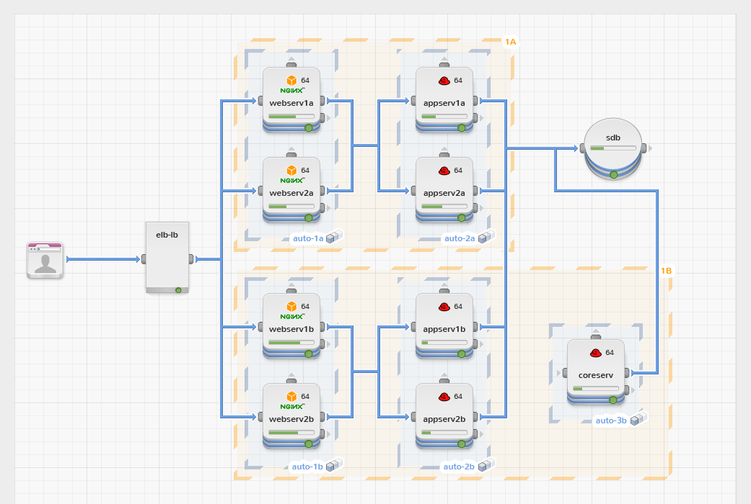

Slide 6
Security
- HTTPs for network traffic
- Bcrypt (salt per user) for password encryption
- AES for user credential encryption
- master secret
- user specific token
- AES secret = our_own_algorithm(master secret, user token)
- No user data or ours in instance’s FS
- No credential or password in source code repo
- Turn off public SSH in production
only allow SSH from our “bridge” server

Slide 7
Q & A

